Slide 1
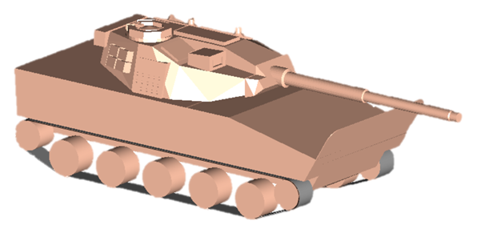
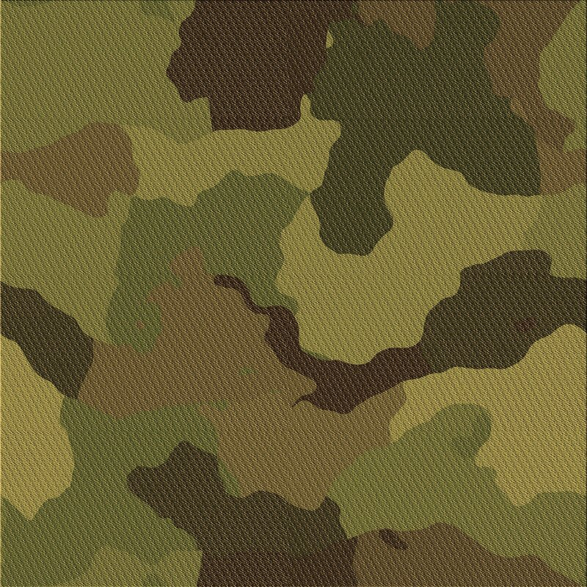
Light Expeditionary Fire Support Vehicle (Experimental)
( )
LEFSV X
Design Study
Jonathan Hale
Patrick F Naughton
July 2nd. 2021

Slide 2
( )
LEFSV X
- Introduction
Force Design 2030
Commandant’s Comments
  Future promise of unmanned vehicles
  Upgrades needed to Light Reconnaissance Force’s vehicles
Counterpoint Comments
  Other Threats
  Legacy Missions
  Current autonomous system limitations
Risk Reduction
  Evolutionary development & upgrades
  “Technology insertion during periodic preplanned upgrade periods”
Development of a Mission Needs Statement
“With the shift in our primary focus to great power competition and a renewed focus on the Indo-Pacific region, the current force has shortfalls in capabilities needed to support emerging joint, naval, and Marine Corps operating concepts” - Force Design 2030
“Provide an expeditionary vehicle with a direct fire capability suitable for supporting USMC ground forces during operations on or around both naturally occurring and man-made islands, including urban areas, in a wide array of littoral environments against a peer, or near peer adversary while also supporting other traditional USMC military missions, including acting as a rapid reaction force to assist friendly nations against hostile attack, providing for the defense of US bases and facilities around the world, and undertaking the evacuation of US personnel in times of strife or natural disasters.” – Derived LEFSV(X) MNS

Slide 3
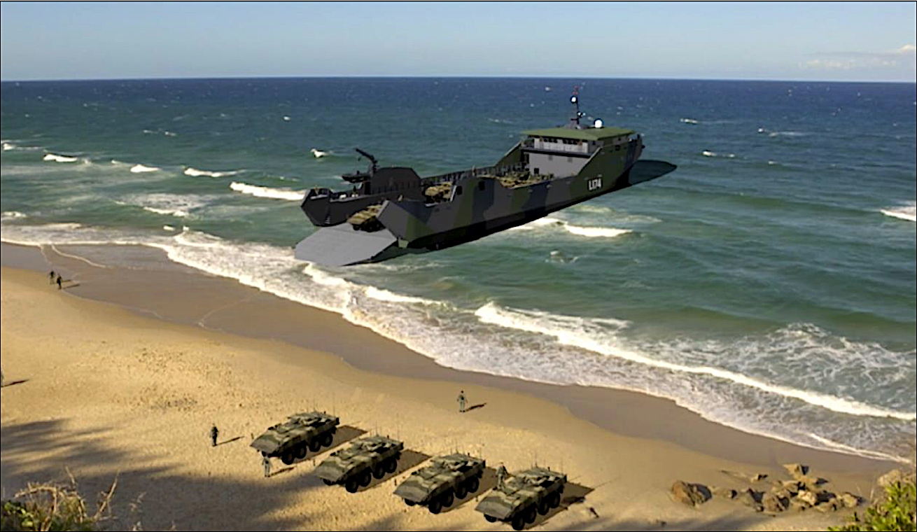
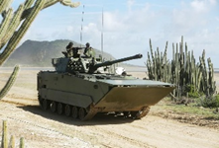
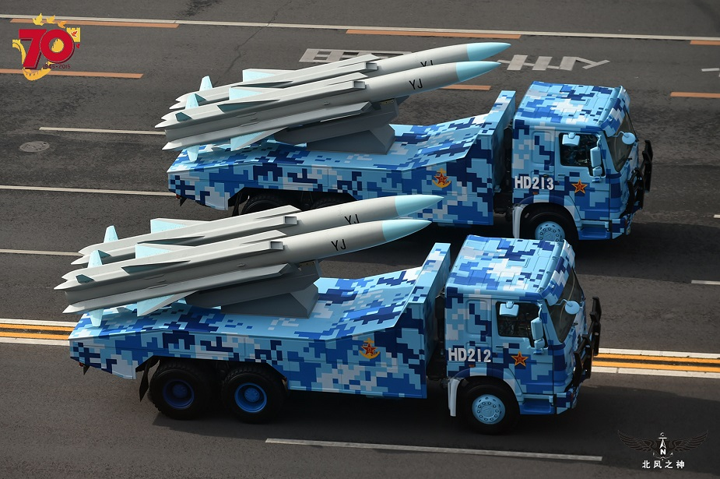
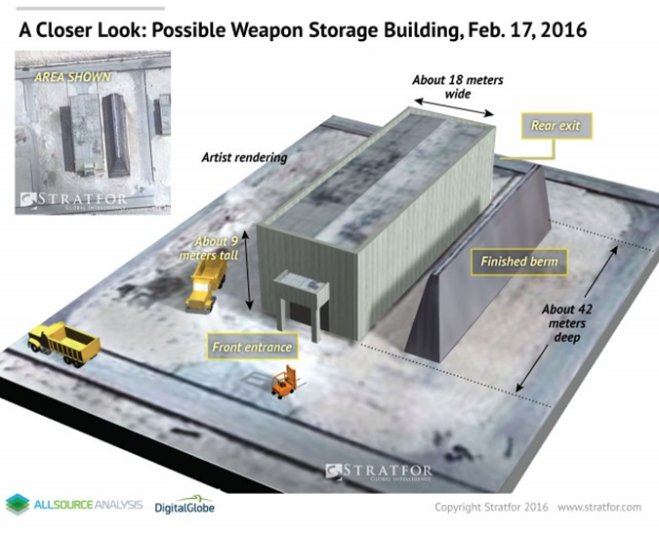
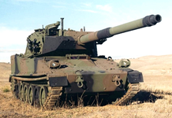
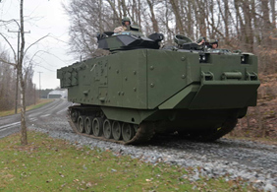
( )
LEFSV X
- Literature Search
Extensive review of potential;
Theater(s) of operation
  Indo-Pacific, Baltic Sea, Mid-East Littorals
  Arctic/Northwest Passage
  Other legacy areas of operations
Threats & Targets
  Vehicles & weapon systems
  Buildings & reinforced structures
  Existing/previous fire support and amphibious vehicle capabilities
Armor and weapon systems capabilities
Concept level design estimating for military vehicles

Slide 4
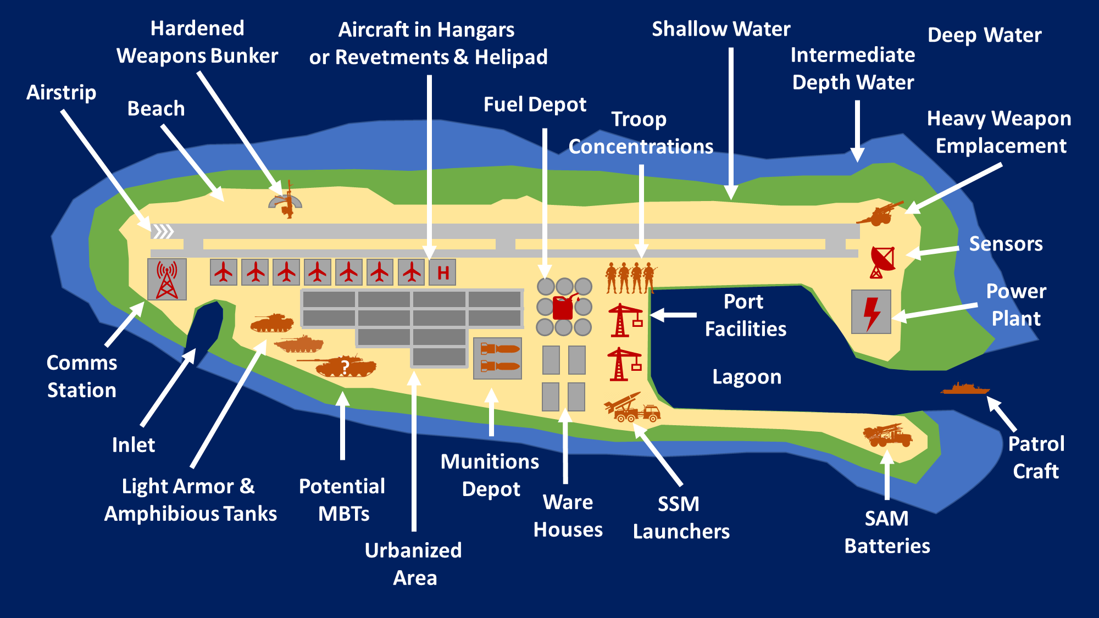
( )
LEFSV X
- Map/OV-0
Issues
Can include Urban Areas
May require destruction of weapon system installations hardened facilities
Not just light enemy forces expected
Not just Littoral Areas of Operation

Slide 5
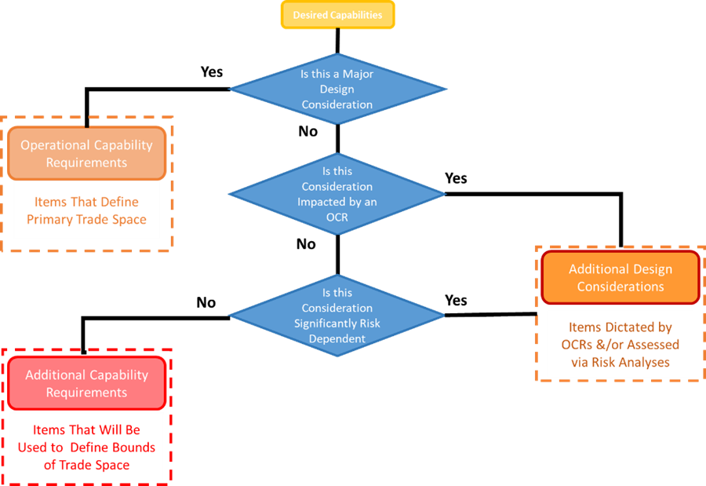
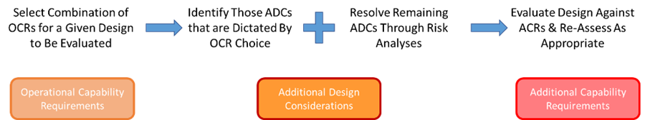
( )
LEFSV X
- Desired Design Characteristics
Desired Design Characteristics (DDCs)
  Divided into
    Operational Capability Requirements (OCRs)
      Bases of primary trade-offs
      Defined by ranges of desired capability
      Includes Levels of Firepower, Protection, Amphibious Capability, and Automation
    Additional Capability Requirements (ACRs)
      Help define bounds or limits to trade space
      Includes Acceptable Weights, Ground Pressure, and Speeds (over Land and Water)
    Additional Design Considerations (ADCs)
      Heavily dependent on OCRs and/or risks
  Intent to try and limit
    Step functions in requirements
    Lesser “desirements” from driving overall design
      If can’t achieve “X”, is 95% “X” good enough

Slide 6
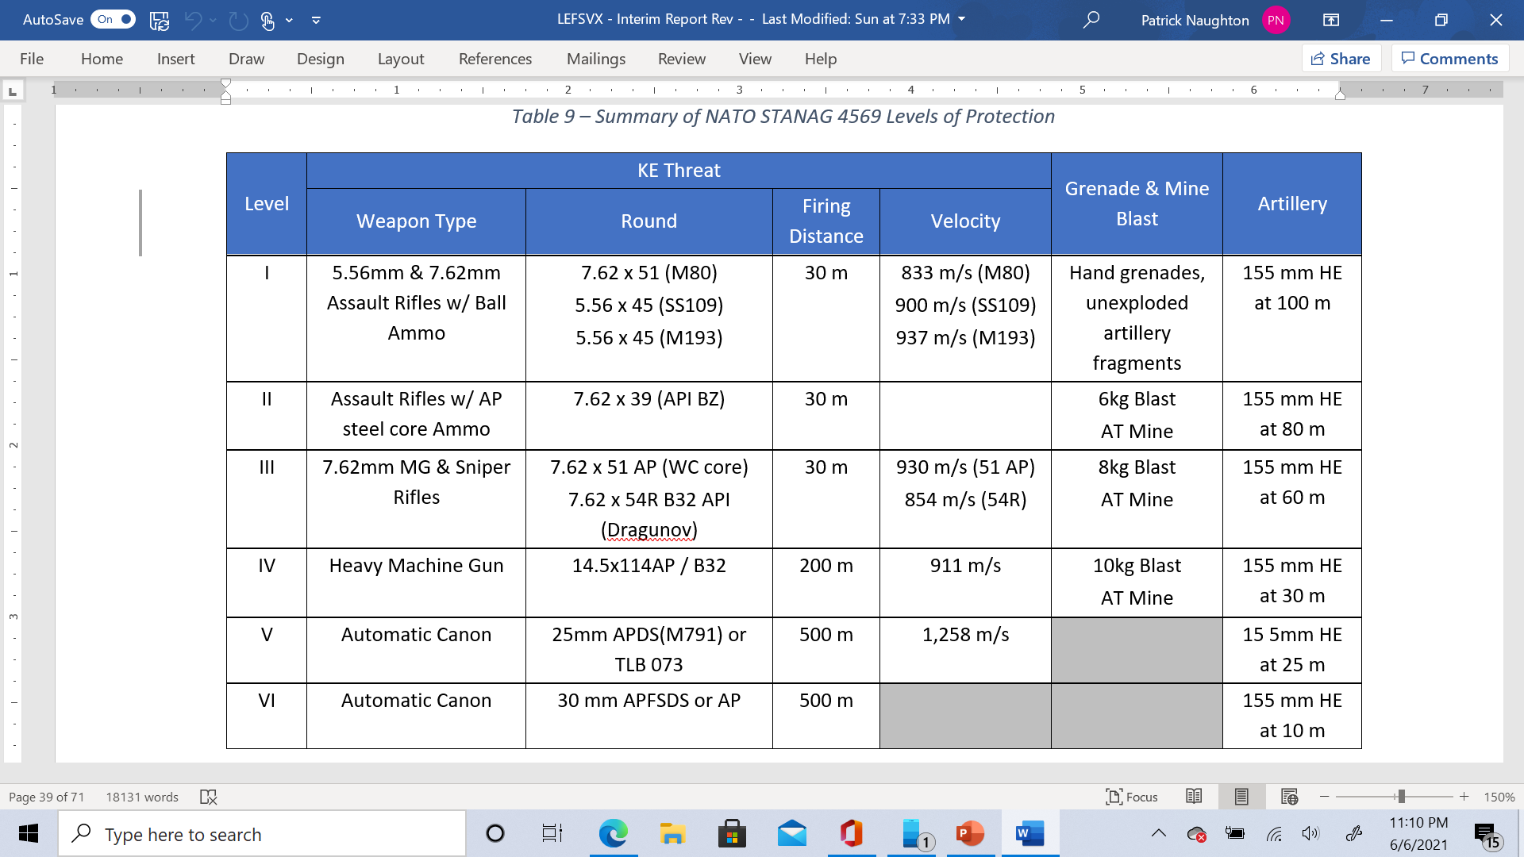
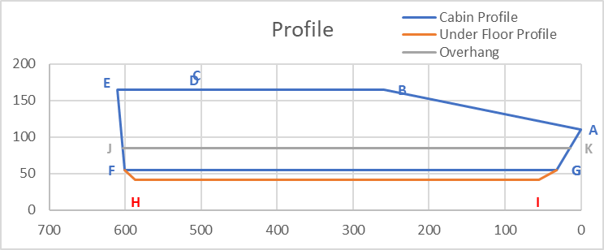
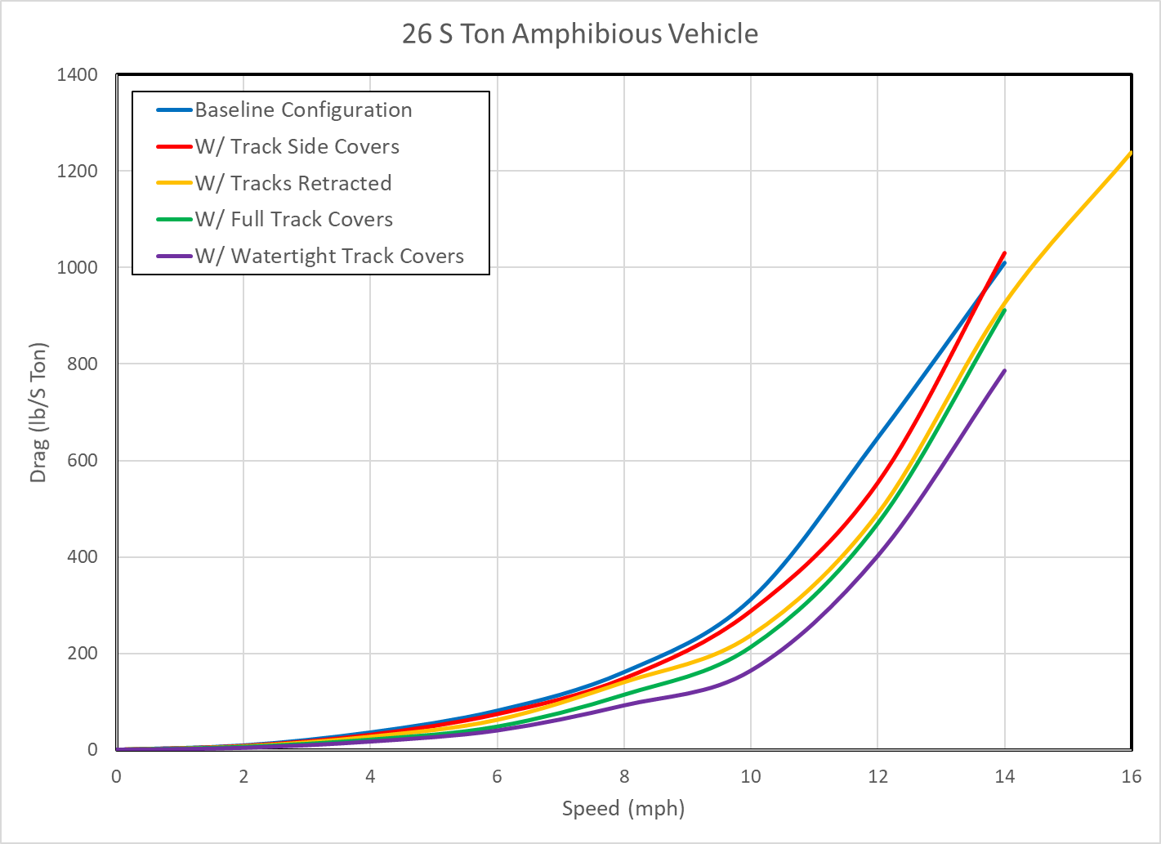
( )
LEFSV X
- Tools & Spreadsheets
Developed a suite of spreadsheets to:
  Estimate hull and armor weights, and protection levels
  Other system weights
  Water borne resistance and impacts of resistance improvement concepts
  Waterjet performance

Slide 7
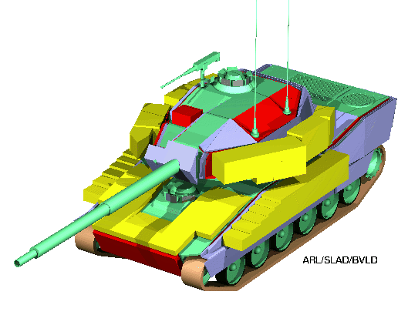
( )
LEFSV X
- Design Point
Low-Risk/Near-Term
Initial sizing based on XM-8 Armored Gun System
  Lightly automated (with autoloader for main gun)
  XM-8 is basis of one of US Army’s MPF concepts
  Sized to fit within C-130 aircraft (when outfitted with limited armor)
Results
Excursions
  Improved amphibious capability
  Larger or smaller caliber main gun
  Alternate suspension concepts
 | Weight (kg) |  | Volume* (m3)
Hull | 5,460 | 29.7% | 3.59 | 29.5%
Suspension | 4,428 | 24.0% | 0.00 | 0.0%
Propulsion Plant | 1,281 | 7.0% | 2.29 | 18.8%
Automotive Drive Train | 1,299 | 7.1% | 0.54 | 4.5%
Marine Drive Train | 0 | 0% | 0.00 | 0/0%
Auxiliary Automotive Systems | 1.082 | 5.9% | 2.83 | 23.3%
Auxiliary Hydrodynamic Systems | 0 | 0% | 0.00 | 0.0%
Weapon Station/Turret | 1,750 | 9.5% | 2.01* | 16.5%
Armament | 992 | 5.4% | 0.00 | 0.0%
Vehtronics | 329 | 1.8% | 0.29 | 2.4%
Load Items | 1,792 | 9.7% | 0.62 | 5.1%
Subtotal | 18,413 |  | 12.16
Margins | 1,841 | 10.0% | 1.22 | 10.0%
Condition A | 20,254 |  | 13.40
* Volume is Volume of Hull only
  Value listed for Turret represents volume of Turret Basket that extends into Hull

Slide 8
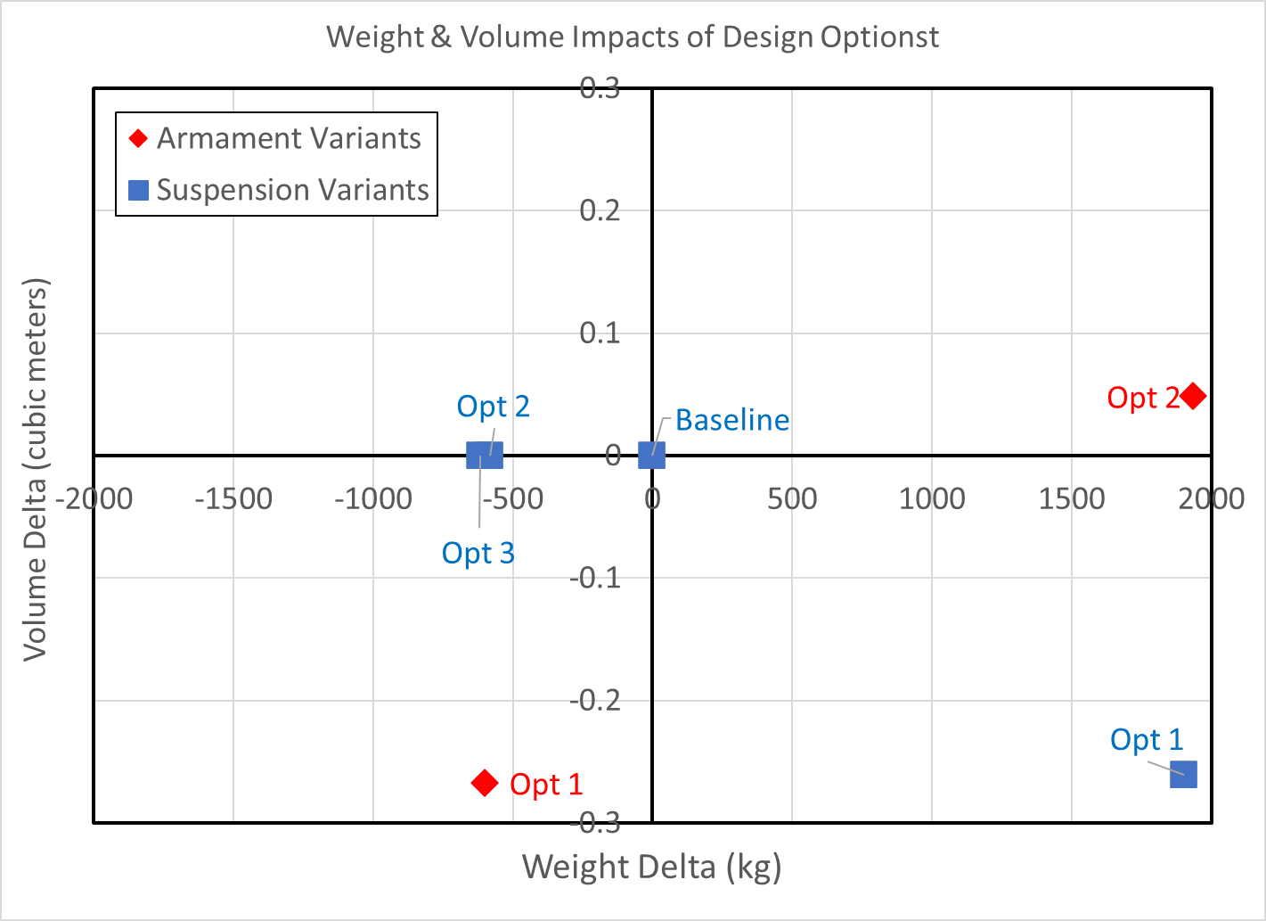
( )
LEFSV X
- Design Point Variants
Alternate Suspensions
Baseline system similar to XM8
Option 1 – Gear more similar to Bradley Fighting Vehicle
Option 2 – Hydro-Pneumatic Suspension
Option 3 – Elastomer Band Tracks
Alternate Main Gun Size
Baseline system uses 105mm Gun
Option 1 – 90mm Gun
Option 2 – 120mm Gun
Increased Amphibious Capability (Modified Hullform)
Baseline – limited capability (similar to M1 or XM8)
Option 1 – Enclosed Water Capability [In-process]
Option 2 – Through Surf Zone Capability [In-process]
Option 3 – Over the Horizon Capability [In-process]

Slide 9
( )
LEFSV X
- Unmanned Issues

Slide 10
( )
LEFSV X
- Results & Conclusions
Results
Researched
  IUSMC decision to retire heavy armored units
  Legacy and emerging USMC missions
  Legacy fire support vehicles and previous design studies
Developed high level requirements for a Light Expeditionary Fire Support Vehicle to support USMC legacy and emerging missions
  Investigated alternate processes for addressing requirements and “desirements”
Developed
  100+ page report summarizing work done to date
  Concept design methodology for light/medium armored fire support vehicles
  Initial design concept and an array of several options
Work ongoing to refine tools and developing more trade-offs
Conclusions
A Light Expeditionary Fire Support Vehicle appears to be a viable option to support current and future USMC missions
A variety of options would need to be further analyzed and reviewed to assess best means of accomplishing design mission

Slide 11
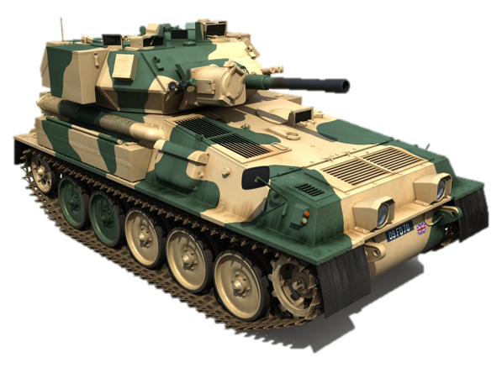
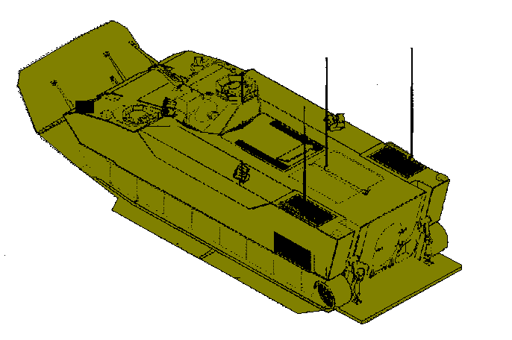
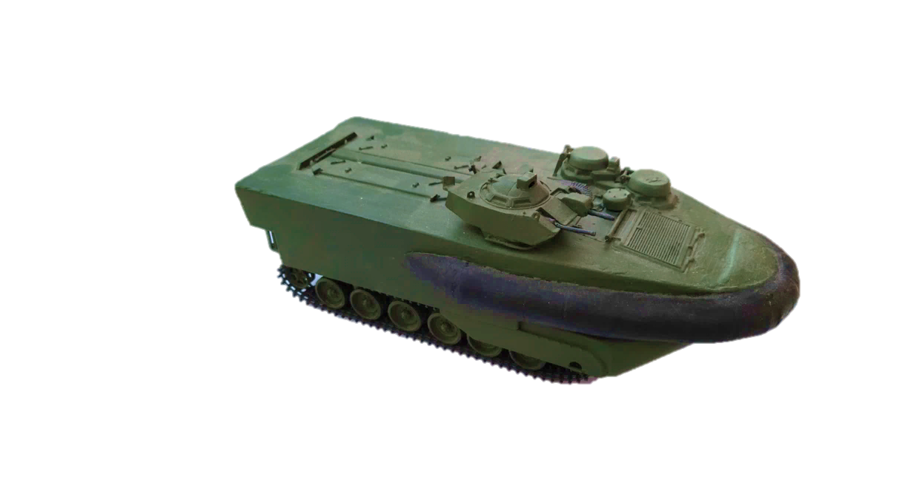
( )
LEFSV X
- Potential Future Work
Additional design points and excursions, such as;
  Minimally sized, manned concept (using FV101 CVR(T) as a basis w/ 75mm or 90mm main gun)
  Over the horizon amphibious capability (EFV-like planing body & flaps)
  Improved safety ideas (inflatable or fixed buoyancy collar)
  Improved hull shape/bow flap ideas
Possible CFD analyses to confirm resistance estimates
Further analyses of
  Autonomous systems
  Alternate power configurations (Fuel cells, Gas Turbines, Hybrid)
  Transmission systems (Electric, Hybrid, Other)
Bow Ramp Image

Slide 12
( )
LEFSV X
- Backups

Slide 13
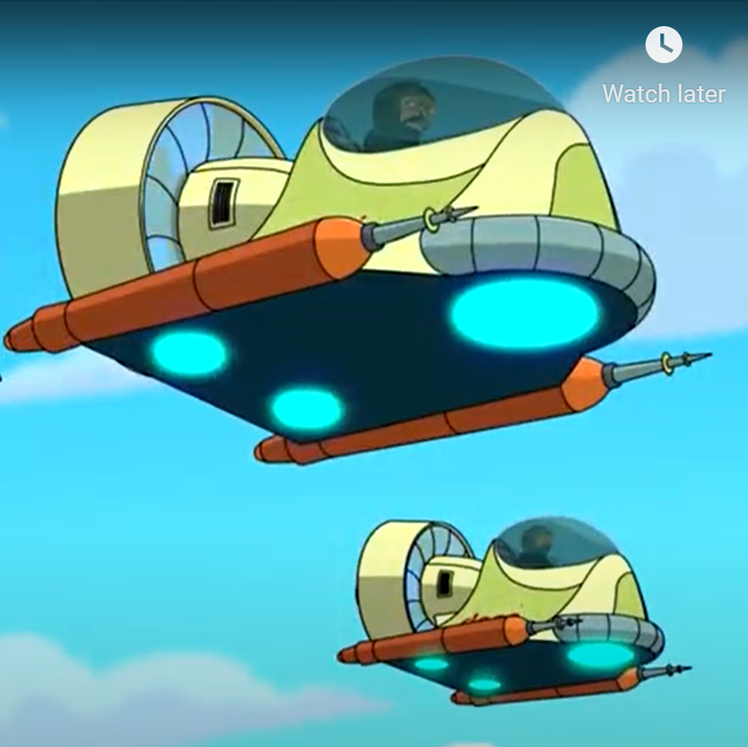
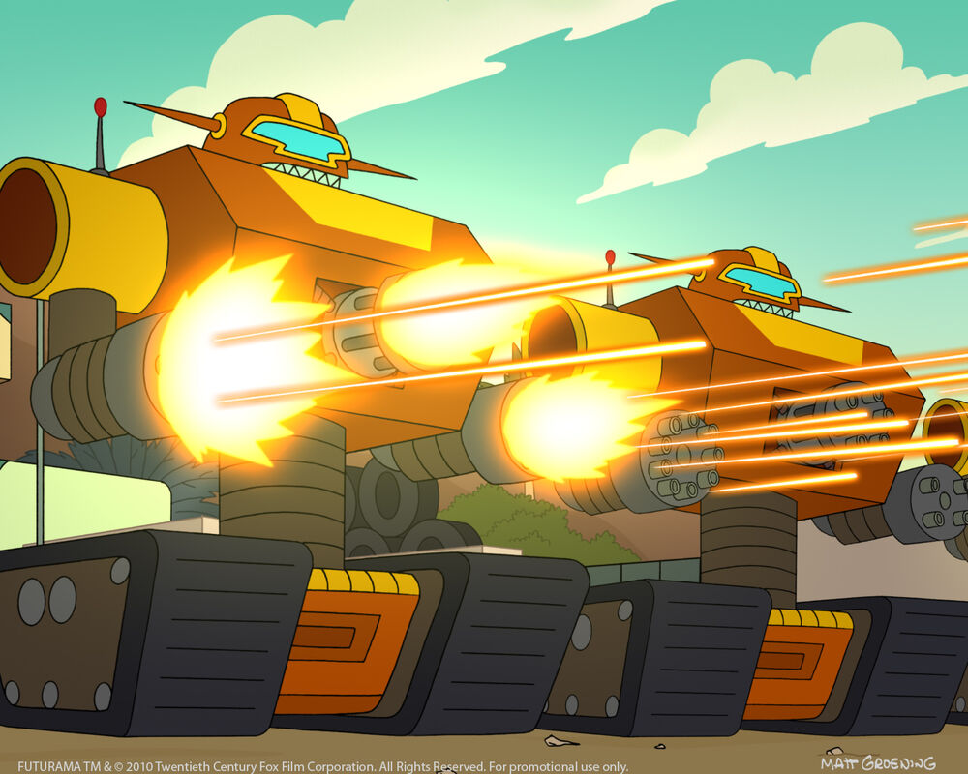
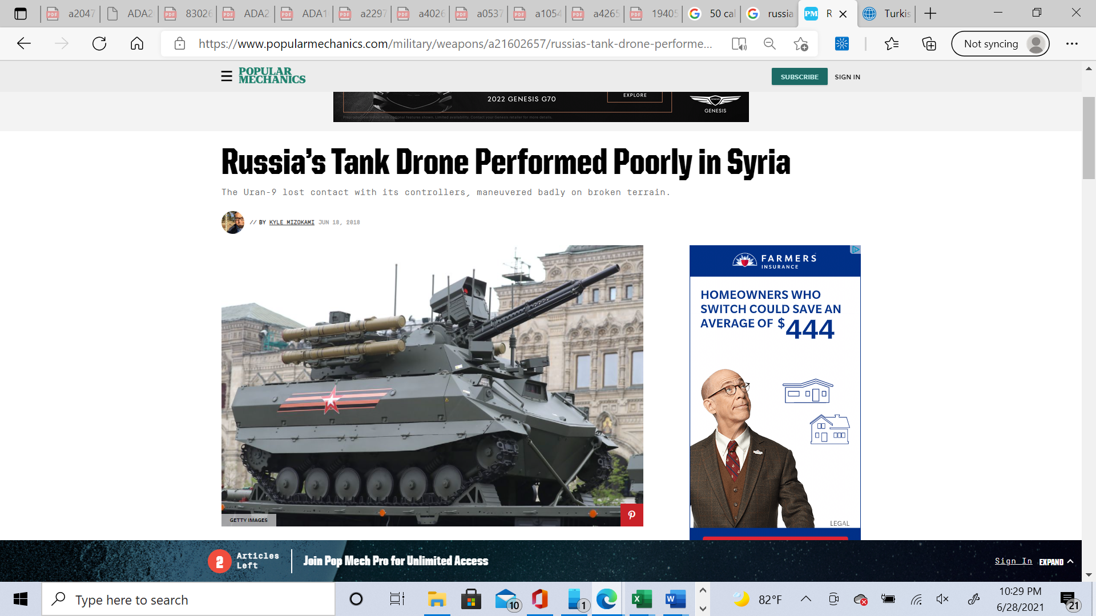
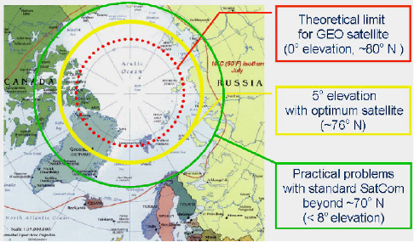
( )
LEFSV X
- Unmanned Issues
Level of Automation
  Fully unmanned
  Remotely piloted or fully autonomous
    Most large caliber autoloaders have a limited capacity
    How are misfires, jams, and malfunctions addressed
  Optionally manned
  What would be required for a single crew to operate vehicle
Comms Issues
  Situational awareness
  Control radius limitations
  Jamming concerns
  How close would operator have to be to the unit
  Polar Region Limitations
  Limited satellite coverage
  IFF (Identification-Friend or Foe)
    What about non-combatants
  Command Authorization
  Are there limitations on whether vehicle can autonomously use deadly force?
Revolution vs Evolution
  “The Future is Now” (for a price)
  Is Non-developmental Technology Yesterdays’ State of the Art
  “Design to Evolve”
Zapp: Behold our latest weapon. A revolutionary fleet of unmanned drones...with men in them.
Leela: Then how are they unmanned?
Zapp: The men are just for ballast.
Killbots have a preset kill limit. Knowing their weakness, I sent wave after wave of my own men at them, until they reached their limit and shut down.

Slide 14
( )
LEFSV X
- Unmanned Issues
Level of Automation
  Fully unmanned
  Remotely piloted or fully autonomous
    Most large caliber autoloaders have a limited capacity
    How are misfires, jams, and malfunctions addressed
  Optionally manned
Comms Issues
  Situational awareness
  Jamming concerns
  Control radius limitations - How close would operator have to be to vehicle
  Polar Region Limitations - Limited satellite coverage
  IFF (Identification-Friend or Foe) - What about non-combatants
  Command Authorization - Are there limitations on whether vehicle can autonomously use deadly force?
Revolution vs Evolution
  “The Future is Now” (for an unknown price “to be determined” later)
  Is “Non-developmental Technology” Yesterdays’ State of the Art
  “Design to Evolve”

